Slide 1
DDIIGGIITTAALL PPOORRTTFFOOLLIIOO

Slide 2


STUDENT NAME :Kalaiyarasi S
REGISTER NO & NMID : 2422k2750 & DBE40063600127CB9104C568B692C675. DEPARTMENT : COMPUTER SCIENCE
COLLEGE : GOVERNMENT ART'S AND SCIENCE COLLEGE KANGAYEM /
BHARATHIYAR UNIVERSITY

Slide 3



PPRROOJJEECCTT TTIITTLLEE
STUDENT PORTFOLIO FOR FRONT APP DEVELOPMENT

Slide 4




AAGGEENNDDAA
1. Problem Statement
Project Overview
End Users
Tools and Technologies
Portfolio Design and Layout
Features and Functionality
Results and Screenshots
Conclusion

Slide 5


PPRROOBBLLEEMM SSTTAATTEEMMEENNTT
In today's digital era, traditional resumes alone are not enough to showcase skills and projects effectively. Many students and professionals lack a structured online presence to highlight their work. A digital portfolio provides an interactive and accessible platform to present achievements, skills, and experiences

Slide 6

PPRROOJJEECCTT OOVVEERRVVIIEEWW
This project is a portfolio website built using HTML, CSS, and JavaScript.
It has sections for About, Skills, Projects, and Contact, navigated without page reload.
The Skills and Projects use card- based layouts with responsive design. The Contact form accepts only Gmail addresses, checks for common mistakes (like “gamil.com”),The design uses modern CSS styles with grids, shadows, and a clean layout.

Slide 7




WWHHOO AARREE TTHHEE EENNDD UUSSEERRSS??
Students/Devel
-opers – for learning form validation.
Web designers – can integrate into login/contact forms.
Businesses – to collect valid Gmail IDs for newsletters or customer registration.

Slide 8
TTOOOOLLSS AANNDD TTEECCHHNNIIQQUUEESS
HTML5 – structure of the form.
CSS3 – styling (background, fonts, colors).
JavaScript (Vanilla) – validation logic and error handling. Browser – Chrome/Edge/Firefox for tes
-ting.

Slide 9



PPOORRTTFFOOLLIIOO DDEESSIIGGNN && LLAAYYOOUUTT
. Clean center-aligned design.
. Background color: light gray for simplicity.
. mage at the top (car photo as per your code).
. Form in the middle with input box + send button.
. validation messages in red (error) and green (s uccess).

Slide 10
FFEEAATTUURREESS && FFUUNNCCTTIIOONNAALLIITTYY
✅ Validates Gmail only.
✅ Checks @ symbol.
✅ Detects common typos like “gamil.com”.
✅ Shows error messages in red.
✅ Shows success message in green.
✅ Auto-hides success message after 5 seconds

Slide 11

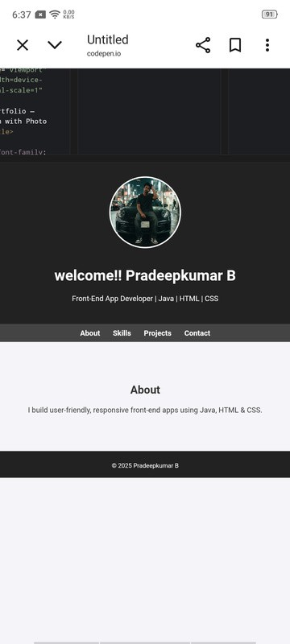
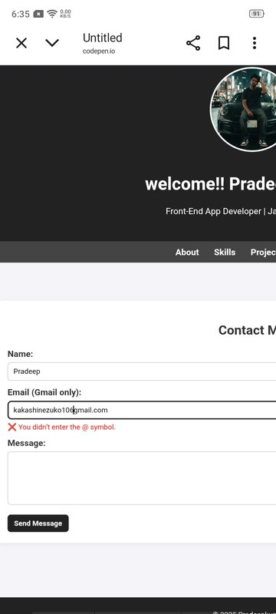
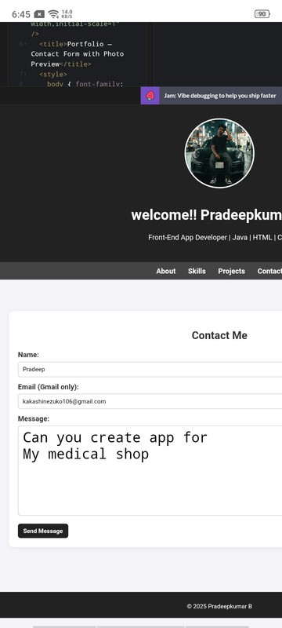
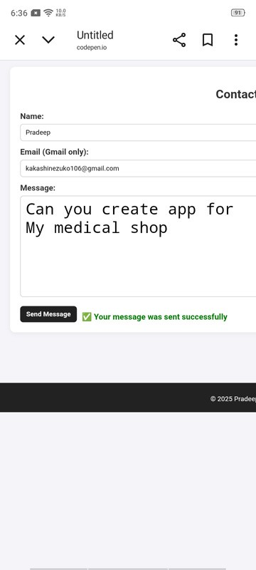
RREESSUULLTTSS && SSCCRREEEENNSSHHOOTT SS

Slide 12



CCOONNCCLLUUSSIIOONN
Implemented a simple, efficient, and user-friendly Gmail validation form.
Helps avoid invalid email submissions.
Enhances user experience and data quality
CAN BE EXTENDED FOR ADVANCED VALIDATIONS (REGEX, MULTIPLE DOMAINS, ETC.).

Slide 13
TTHHAANNKK YYOOUU

